Slide 1
Topic: KS3 Electricity – Lesson 3
Measuring Voltage

Slide 2
Learning Objective
To investigate the best citrus fruit to use to make a battery.
Success Criteria
To carry out an investigation to measure voltage.
To explain how a battery works using scientific keywords.
To apply your knowledge of batteries to explain how a fruit battery can power a mobile phone.

Slide 3
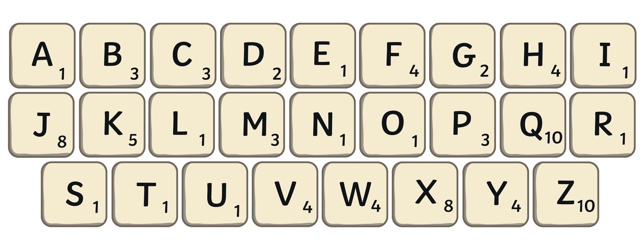
Starter: Scrabble
Calculate how much each of todays keywords are worth.
voltage
11
current
9
battery
12

Slide 4


Voltage
What is voltage?
The voltage of a battery tells us how much energy it provides to the components in the circuit.
It also tells us how hard a battery pushes the electrons in a circuit: the bigger the voltage, the bigger the push.
The strength of the push provided by the battery is called the voltage.
Voltage is measured in volts (V).

Slide 5
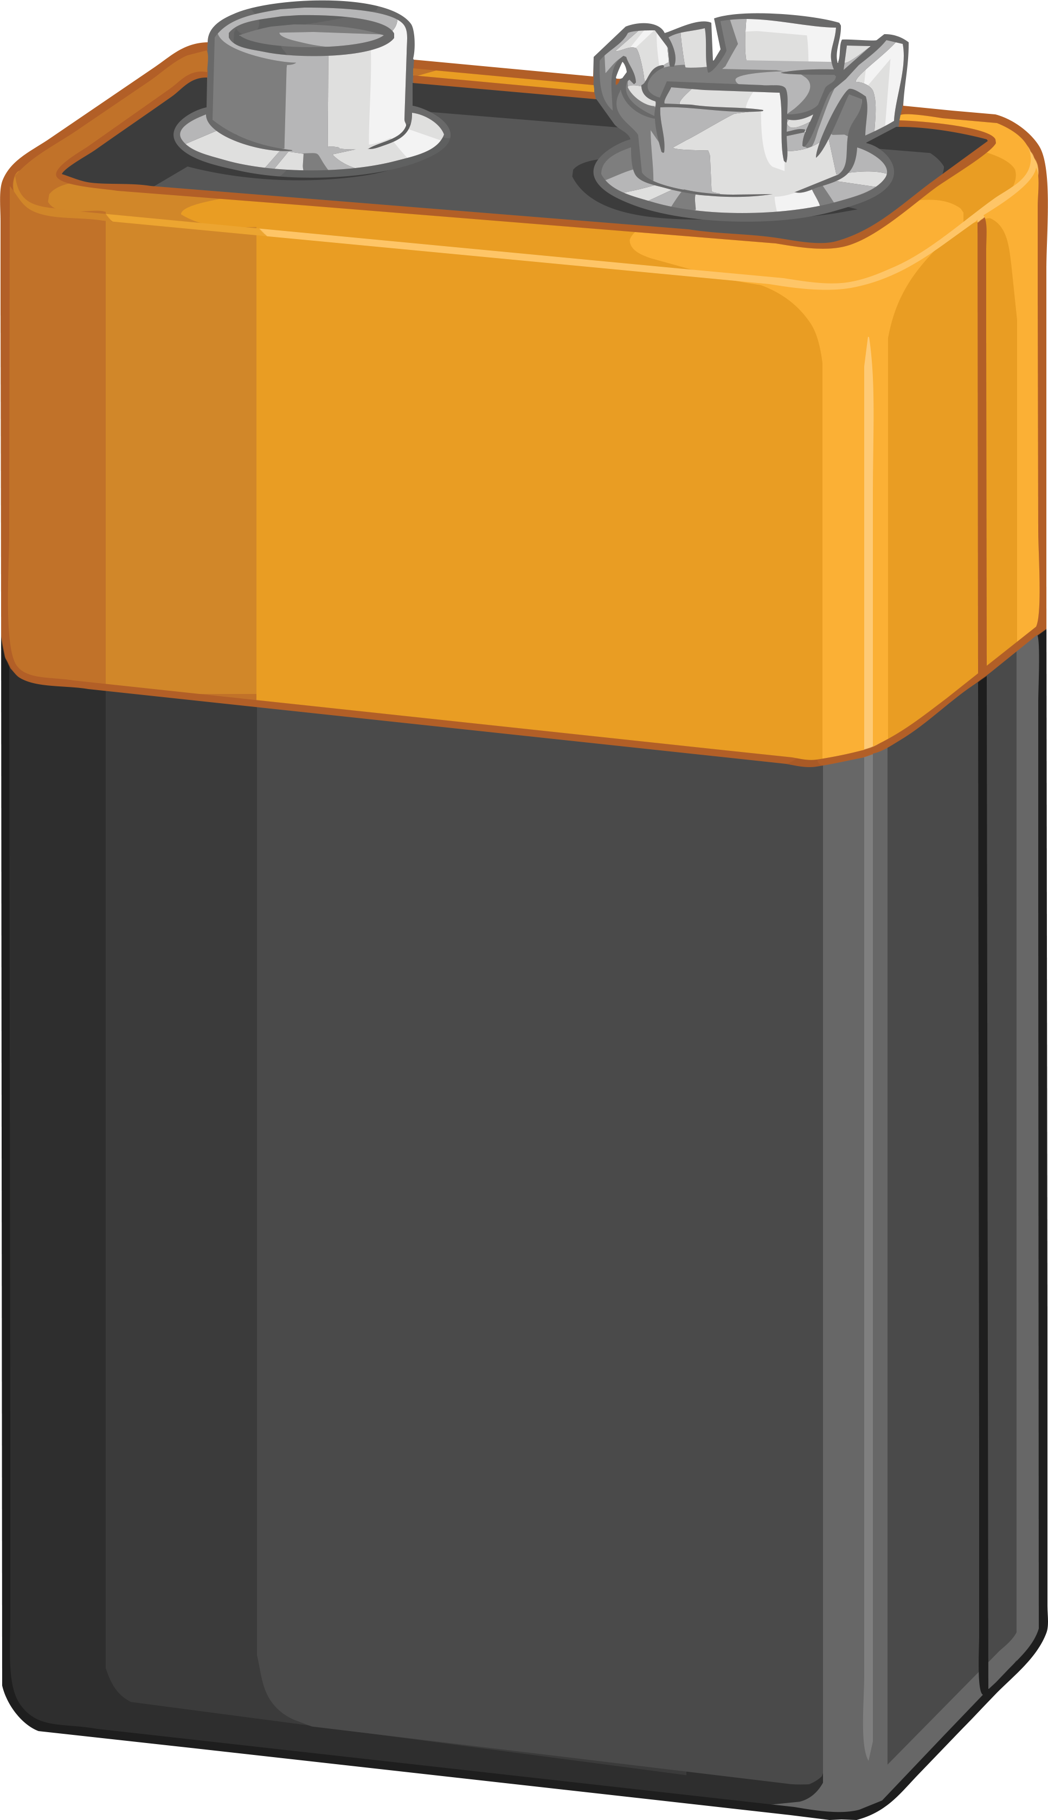
Batteries
Batteries store chemical energy and transform it into electrical energy. This is how batteries are able to power our electronic devices, like mobile phones, torches and a lot more.
Batteries contain an electrolyte and two electrodes. One of the electrodes is positively charged and the other negatively charged. A chemical reaction between the two electrodes creates a flow of electrical energy to the device.
Citrus fruits such as oranges, lemons and limes are highly acidic. The more acidic the fruit is, the better it is for conducting electricity.
The fruit contains positively charged ions. When you insert the metal strip into the fruit, the negatively charged ions start to move from the fruit to the metal strip leaving the protons in the fruit.
It is this movement of negative charges that generates electricity as soon as you attach the wires to the nail.

Slide 6



Knowledge Check Question A
In your own words, explain how a battery works. Use the keywords to help you frame your answer.
Key Terms
chemical energy
acidic
electrolyte
electrode
chemical reaction
charges

Slide 7
Knowledge Check Question B
In your own words, describe/explain how a battery works. Use the keywords and sentence starters to help you frame your answer.
Batteries work by storing …
The battery inside contains…
The electrodes are…
Key Terms
chemical energy
acidic
electrolyte
electrode
chemical reaction
charges

Slide 8
Knowledge Check Question C
Describe how a battery works. Use the keywords to help you fill in the blanks.
Batteries store and transform it into electrical energy.
This is how batteries are able to our electronic devices.
Batteries contain an and two .
One of the electrodes is charged and the other
charged.
A between the two
electrodes creates a flow of electrical energy to the device.
Citrus fruits such as oranges, lemons and limes are
highly .
When you insert the metal strip into the fruit, the
negatively charged ions start to move from the fruit to the
metal strip.
It is this movement of that generates .
Batteries store and transform it into electrical energy.
This is how batteries are able to our electronic devices.
Batteries contain an and two .
One of the electrodes is charged and the other
charged.
A between the two
electrodes creates a flow of electrical energy to the device.
Citrus fruits such as oranges, lemons and limes are
highly .
When you insert the metal strip into the fruit, the
negatively charged ions start to move from the fruit to the
metal strip.
It is this movement of that generates .
Key Terms
electricity
charges
acidic
chemical reaction
negatively
positively
electrolyte
electrodes
chemical energy
power

Slide 9
Answers
Describe how a battery works. Use the keywords to help you fill in the blanks.
chemical energy
Batteries store and transform it into electrical energy.
This is how batteries are able to our electronic devices.
Batteries contain an and two .
One of the electrodes is charged and the other
charged.
A between the two
electrodes creates a flow of electrical energy to the device.
Citrus fruits such as oranges, lemons and limes are
highly .
When you insert the metal strip into the fruit, the
negatively charged ions start to move from the fruit to the
metal strip.
It is this movement of that generates .
power
electrolyte
electrodes
Key Terms
electricity
charges
acidic
chemical reaction
negatively
positively
electrolyte
electrodes
chemical energy
power
positively
negatively
chemical reaction
acidic
charges
electricity

Slide 10

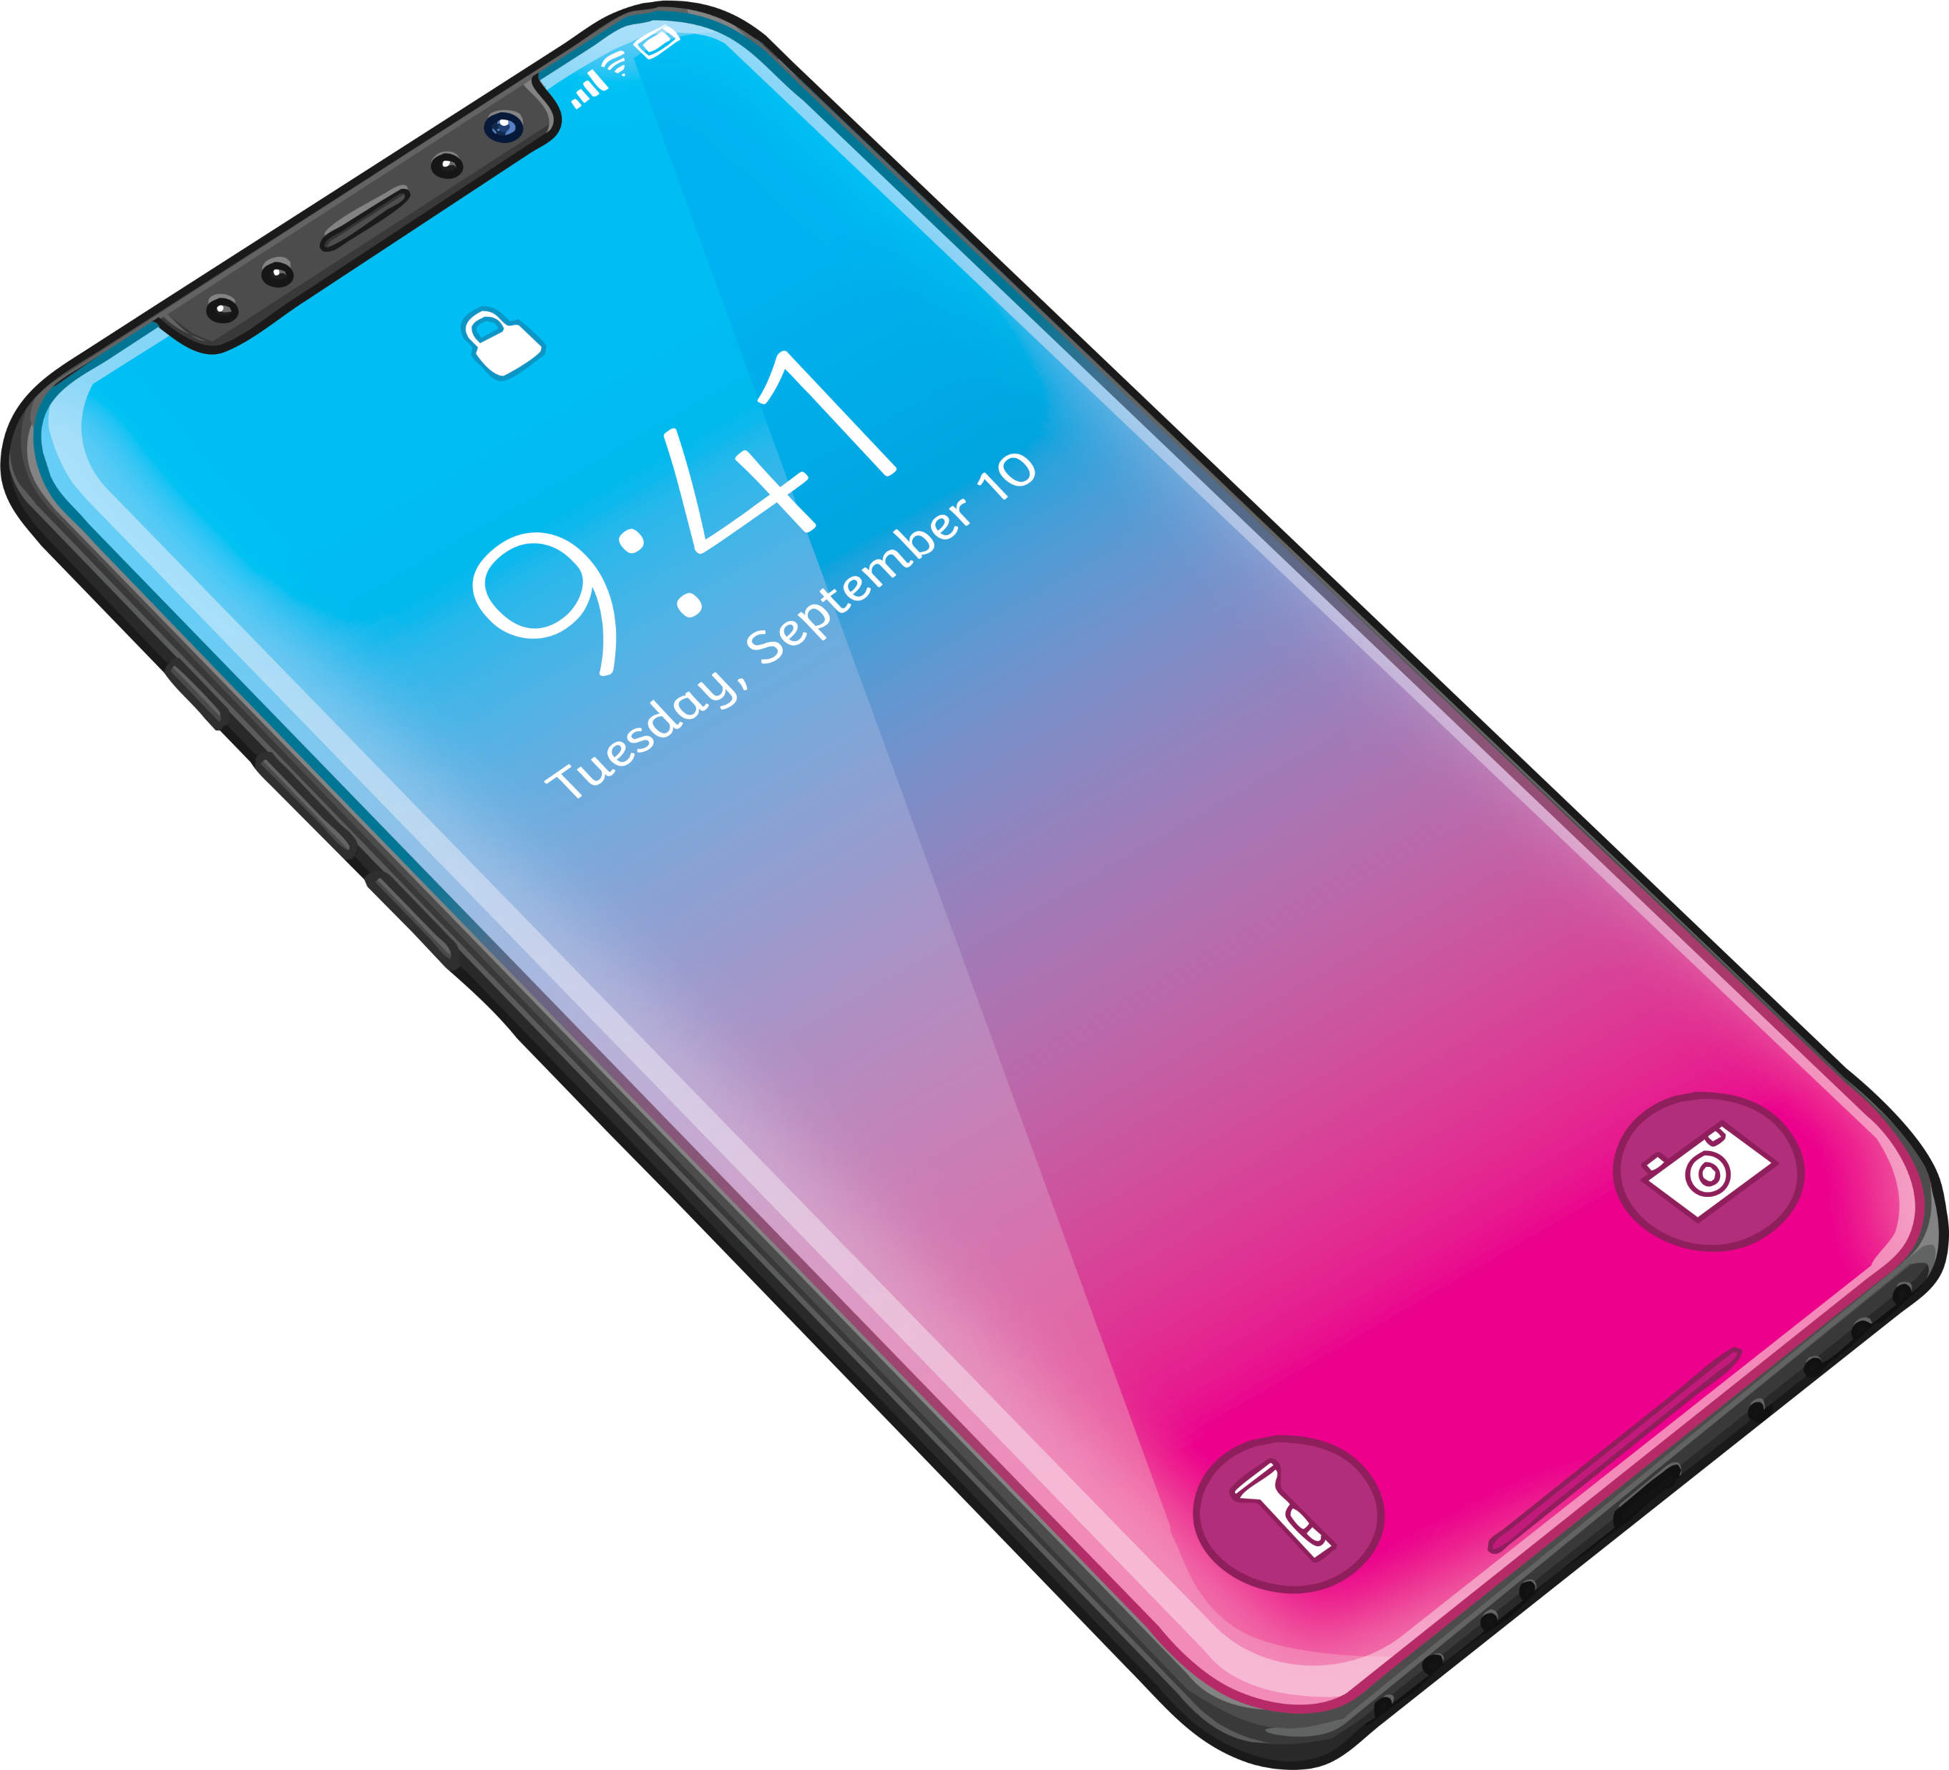
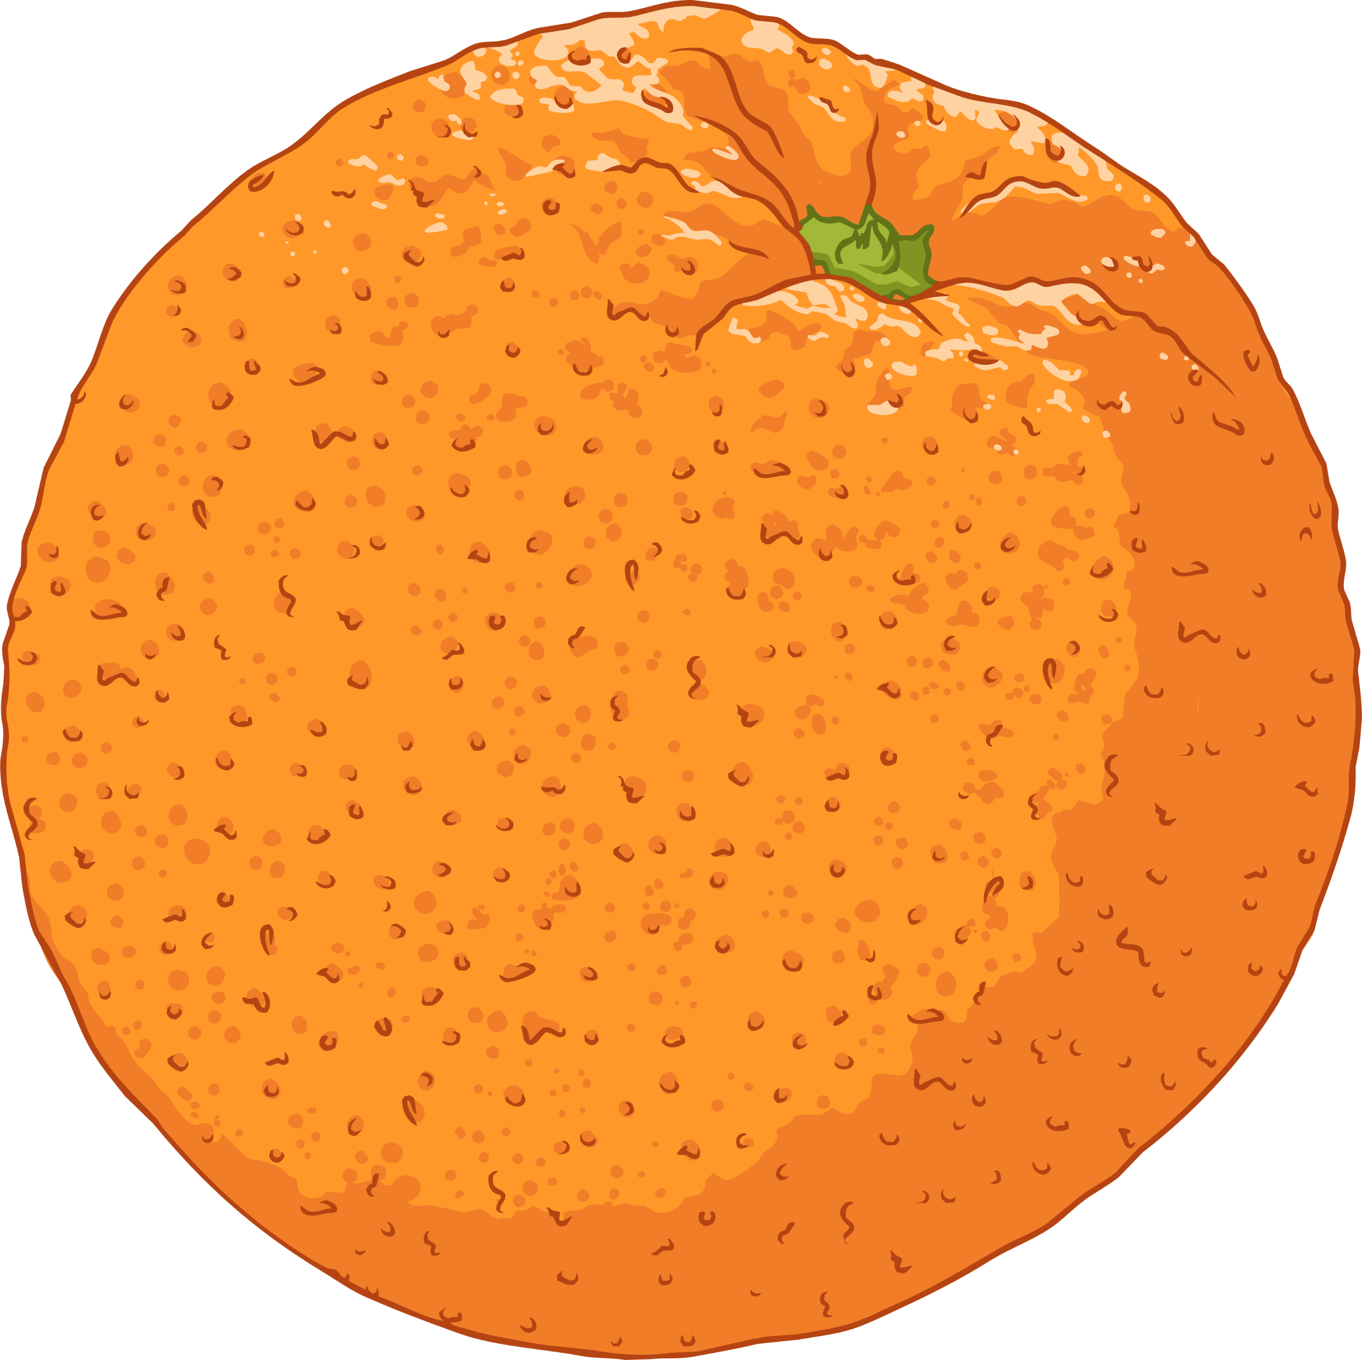
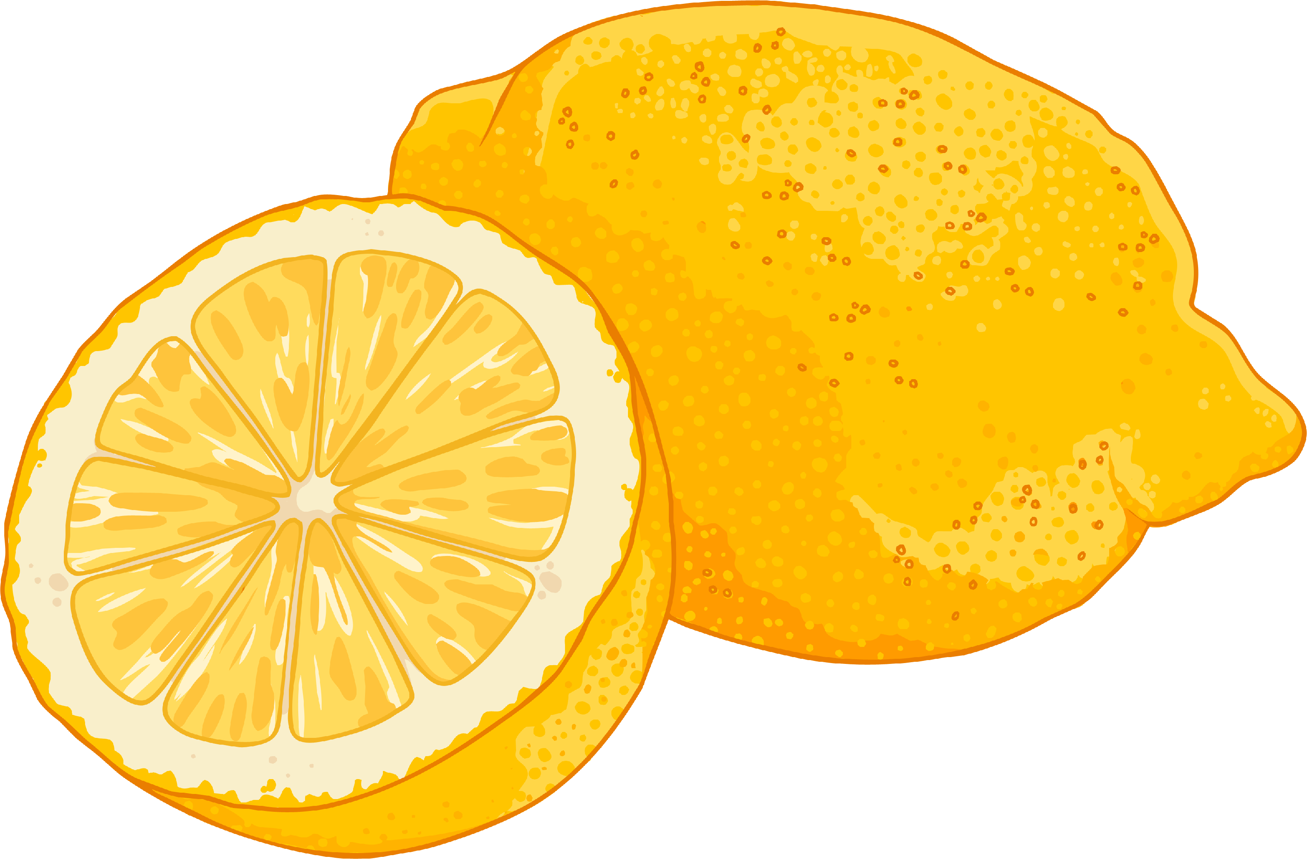
Fruity Battery Investigation
You are currently a scientific researcher working for a major mobile phone company. The company has asked you to investigate the possibility of moving away from lithium batteries and use an environmentally friendly alternative, such as citrus fruit.
Your boss has told you that the average mobile phone needs 4V to charge it.
In groups, you are going to carry out an investigation to see which citrus fruit would make the best battery to power a mobile phone.

Slide 11
Fruity Battery Investigation
What are the variables in this investigation?
Independent Variable (what we change):
fruit
Dependent Variable (what we measure|):
voltage
Control Variable (what we keep the same):
equipment and method used
Prediction
Which fruit do you think will produce the most electricity and why?

Slide 12
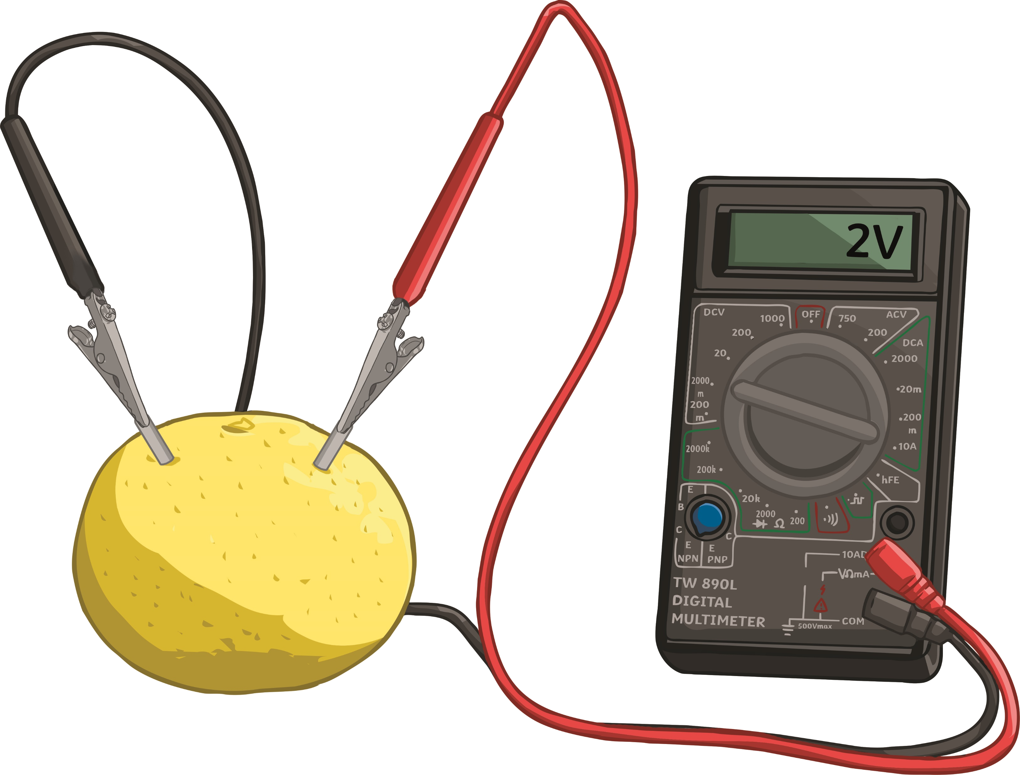
Fruity Battery Method
In your groups, you will need to collect the following pieces of equipment:
1 piece of each fruit, 1 strip of copper, 1 strip of zinc, 2 crocodile clips, 1 voltmeter and 2 wires.
Step 1 – Collect the equipment.
Step 2 – Place the fruit on a table and gently roll it around to soften it up.
Step 3 – Connect each of the wires to the voltmeter.
Step 4 – Attach crocodile clips to the opposite end of each wire.
Step 5 – Insert both pieces of metal into the piece of fruit.
Step 6 – Connect the crocodile clips to the metal.
Step 7 – Record the readings from the voltmeter
in your table.
Step 8 – Repeat the steps above for each of the
fruits.

Slide 13

Conclusion
Which citrus fruit created the biggest voltage?
Why don’t we use fruit instead of batteries?
Did you find any anomalous results?
How do you know the result(s) were anomalous?
How could we improve the investigation for next time?

Slide 14


Summarise what you have learnt today in...
three sentences.
two words.
one letter
(justify why you chose that letter).

